Slide 1


Alpha Phi Omega
Chi Chapter at UCLA
Alpha Mu / Kay Krenek Term, Meeting 1
October 15, 2014
www.apo-x.org

Slide 2
Agenda
1. Officer Updates and Announcements
2. National Convention Voting Delegates Election
3. Last Announcements

Slide 3
President
Raymond Mai
president@apo-x.org
Executive Committee
excomm@apo-x.org

Slide 4
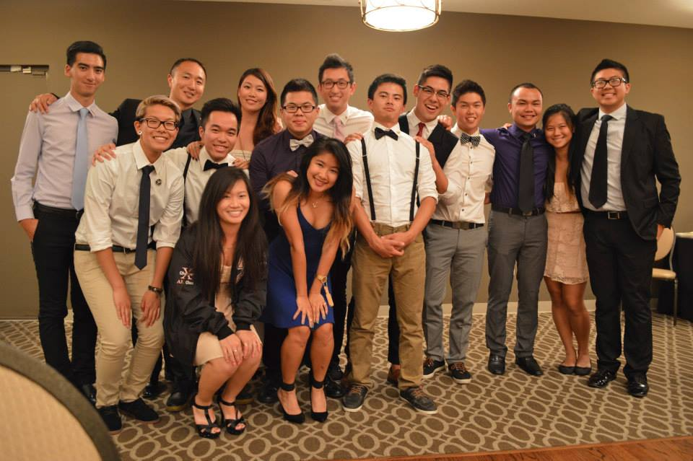


Welcome to Alpha Mu Term
Don’t ever hesitate to speak your mind, provide critiques, or offer suggestions because your Executive Committee (Excomm) is excited to be here so that we can serve YOU.

Slide 5
Points of Focus This Term
UNITY
Promote our values
Instill a culture of true camaraderie
Promote a safe space culture
GROWTH
Expand and grow our service and leadership programs
Develop efficiency and potential in chapter operations
PURPOSE
Provide opportunities for all to feel included, respected, and responsible for the success of this chapter and our community

Slide 6
Expectations & Goals
Expand service towards Brothers/our campus
Mental Health Awareness Program
Comprehensive Involvement List
Service with/for on-campus organizations
Expand leadership program
Career Development Initiative
Enhance accountability measures
Excomm Benchmark Goals
Improve communication efforts
Centralized Communication System
Effectuate efficiency and transparency
Objective leadership
Balanced culture of being casual and professional
Google Drive with all relevant documents
Notes:
As we push for more service to the community, we must remember that service to our chapter because we are still a fraternity and part of being a fraternity is to have strong Brotherhood and help each other out. Additionally, we must promote service to our campus in order to directly help ours peers.

Slide 7
Centralized Communication System
1-2 texts sent out a week to the active chapter in order to centralized chapter-related communication efforts
Sign up at “Cel.ly”
Unlike GroupMe, texts from everyone will funnel to myself
Notifications will include reminders on meetings, LGN, banquet, election stuff, and etc.

Slide 8
Career Development Initiative
Implement a program to increase Career Development efforts
Be active in posting resources and ways to obtain mentors and job/internship opportunities
Career Development workshops on LinkedIn, resumes, cover letters, interview tips, networking tips
Work with Admin VPs to bring back Alumni Networking Night

Slide 9
Mental Health Awareness Program
Campus wide campaign pushed forward by our student government
Will bring in a former member of Actives Minds, under Student Wellness Commission, to briefly speak about mental health resources
Urge all of you to look out for each other, notice any negative trends, and be open to speaking with each other

Slide 10
Administrative VPs
Kevin Quizon & Nicola Yip
admin@apo-x.org

Slide 11

What do we do?
Website
Alumni Relations
Publicity

Slide 12
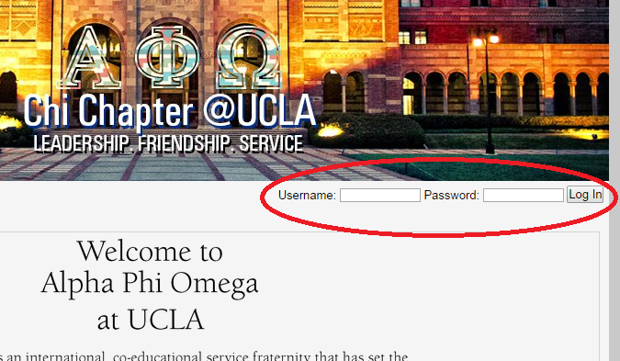
Signing up for events
Login to the website at www.apo-x.org

Slide 13
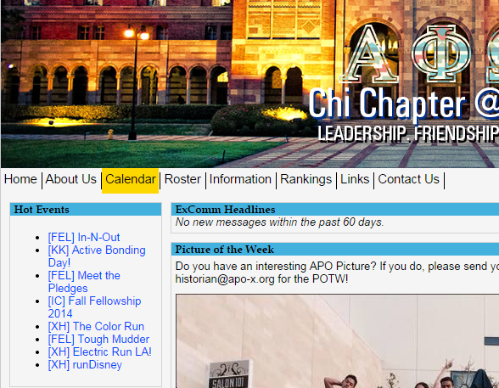
Signing up for events
Click “Calendar” on Toolbar and browse events!

Slide 14
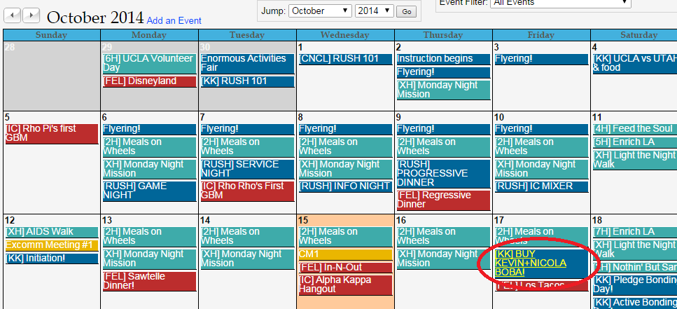
Signing up for events
Click on an event and sign up for the appropriate shift!

Slide 15
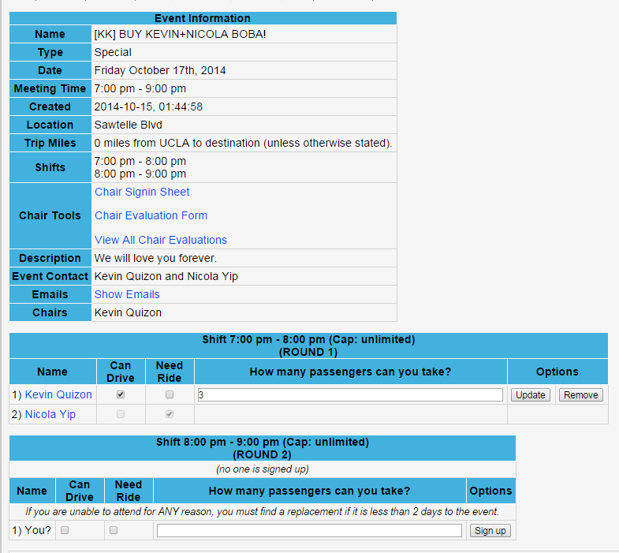
Signing up for events
If any, follow special instructions in the description to sign up for the event!

Slide 16
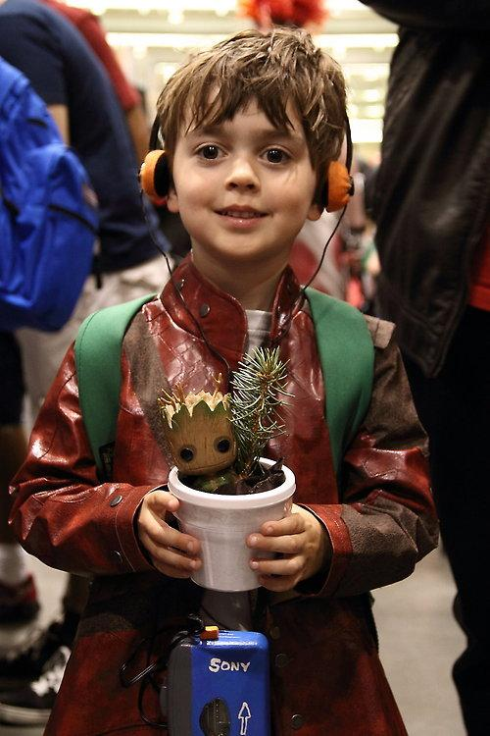
Alumni Mentorship Program
For all you aspiring superheroes…
Stay tuned for more details!

Slide 17
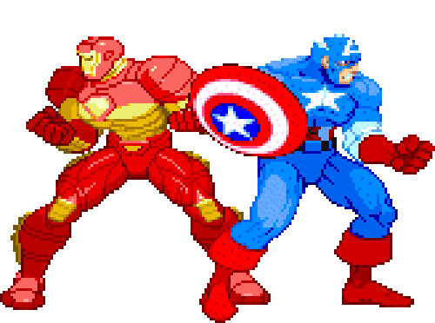
Join our committees!
Alumni Liaison (2 positions)
Send out polls and compile availabilities
Publicity (1 position)
Manage and update social media outlets
Newsletter (5 positions)
1 creative
1 editor
3 columnists

Slide 18
Membership VP
Jeremy Gozzip & Andrew Suh
membership@apo-x.org

Slide 19
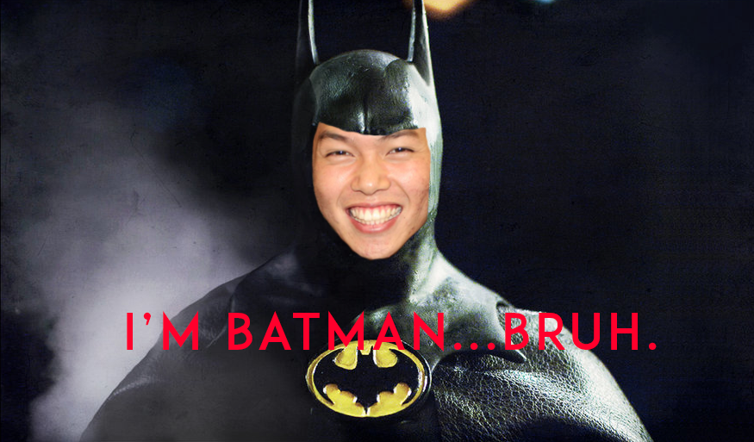

Slide 20
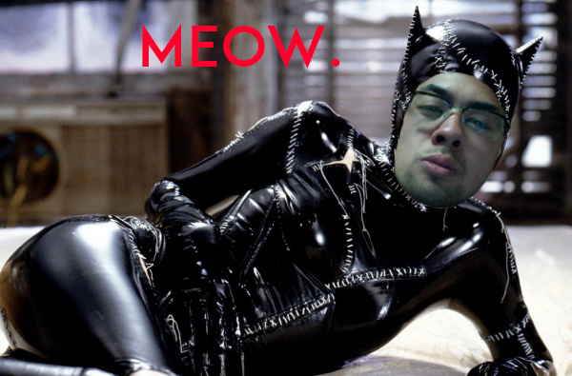

Slide 21

Changed Requirements
9 out of 12 meetings
1 out of 2 election meetings
2 Events to be chaired
1 leadership workshop/Excomm meeting
$20 Fundraising
*REMEMBER TO START THINKING ABOUT COMMITTEES IF YOU HAVEN’T ALREADY! :)

Slide 22

Active Bonding Day
THIS SATURDAY
3-6pm at Veteran Park
*We are looking for at least 40 people
UNLIMITED TACOS + BROTHERHOOD!
NOTE: Bring $8 for food plz. But I mean TACOS!!!

Slide 23
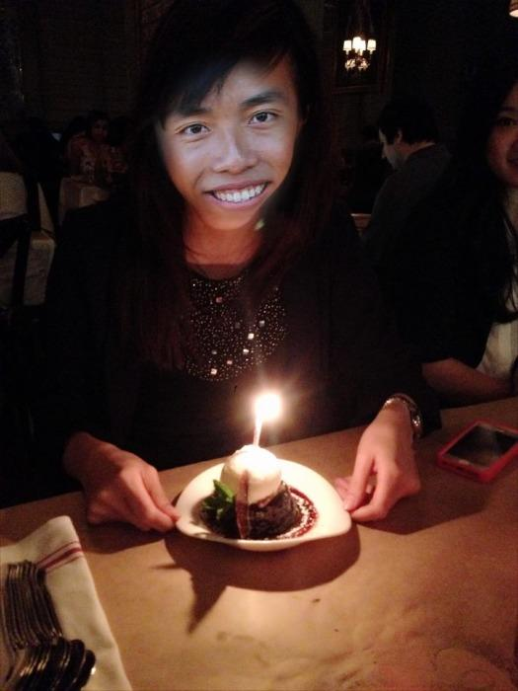
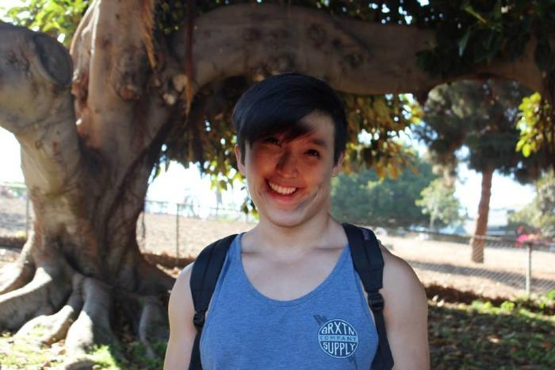
AM Family Heads!
ALPHAS- Claudia Wijaya + David Yuan

Slide 24
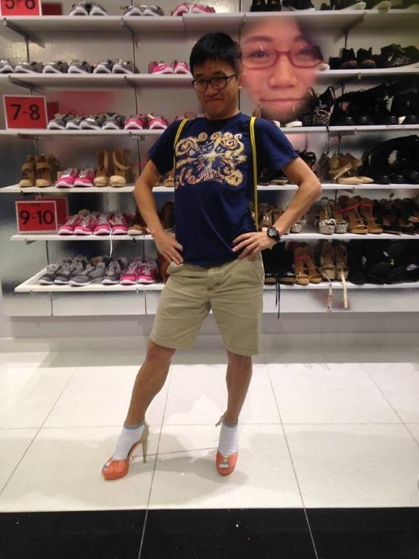
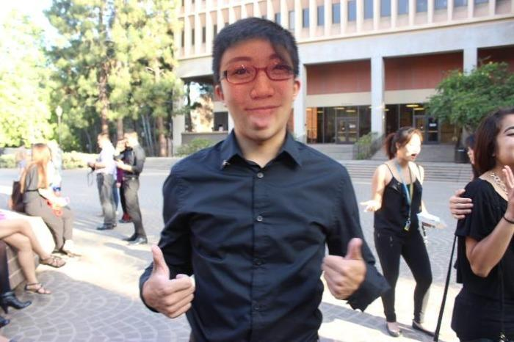
AM Family Heads!
PHIS
Jonathan Pang +
Sharon Yu

Slide 25
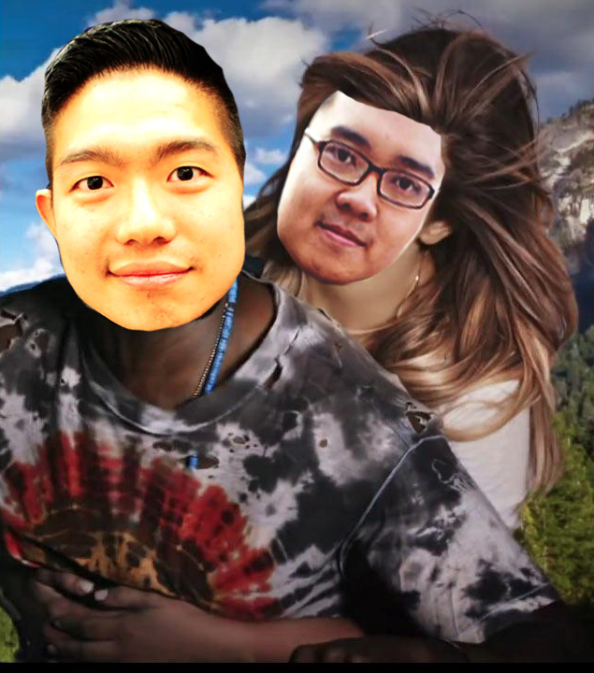
AM Family Heads!
OMEGAS
Mark Zhang +
Hoang Duc Luu

Slide 26
GAME - “LYRICS”
1)Turn system A->P->O->Pledges
2)Cue song->Stop->Family finishes lyrics
3)Fam unable to answer in 10sec,
UP FOR GRABS!
Family with most points win! (12songs)

Slide 27
Service VP
Rui Guo
apoxservice@gmail.com

Slide 28
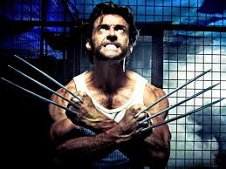
What do I do?
SERVICE

Slide 29
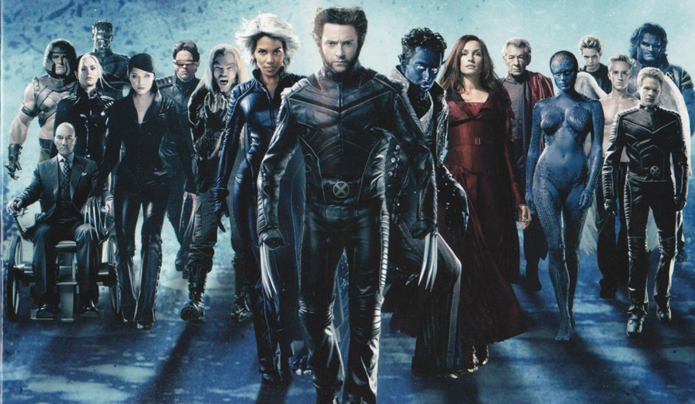
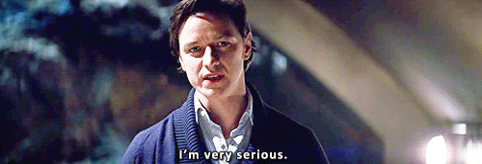
Join my committees!
Tracking Committee (2)
Events Committee (1)
President’s Award (1)
Circle K Committee (2)

Slide 30

Milestone Achievements!
Anyone who completes 15 hours by CM3
Prize: Leather engraved bracelet
First three to complete 50 hours
Prize: Service tank
Anyone who finishes 100 hours
Prize: President’s Volunteer Service Award

Slide 31
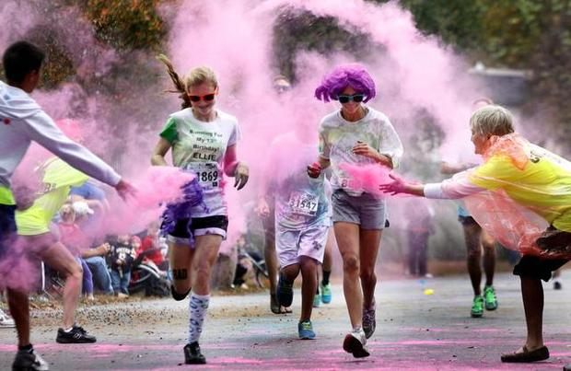
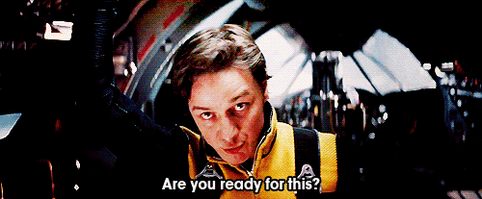
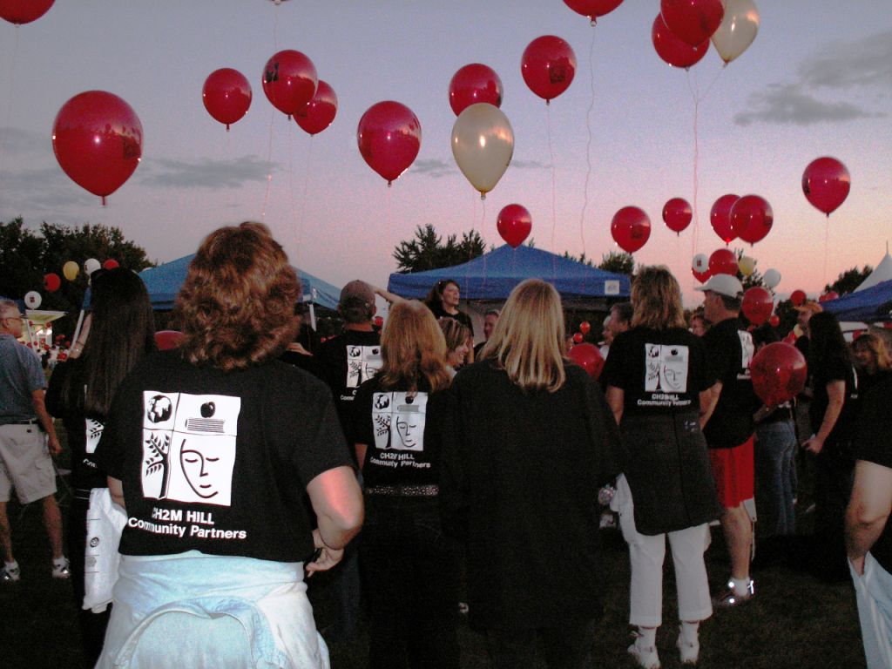
Upcoming events!
Light the Night Walk 10/18
Santa Monica RunFest 10/19
The Color Run 10/25
Electric Run 11/08

Slide 32
Pledge Parents
Brian Lee & Emily Neai-Proeung
apoxpparents@gmail.com

Slide 33
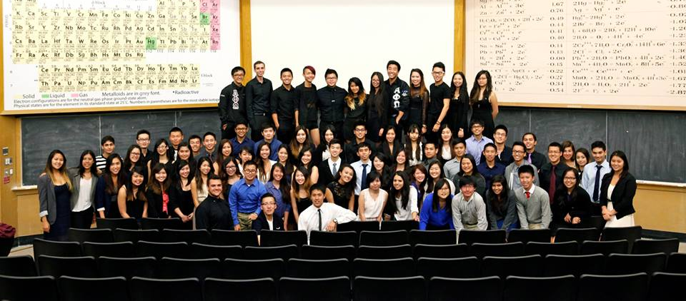
Welcome Alpha Mu//Kay H. Krenek Term!

Slide 34
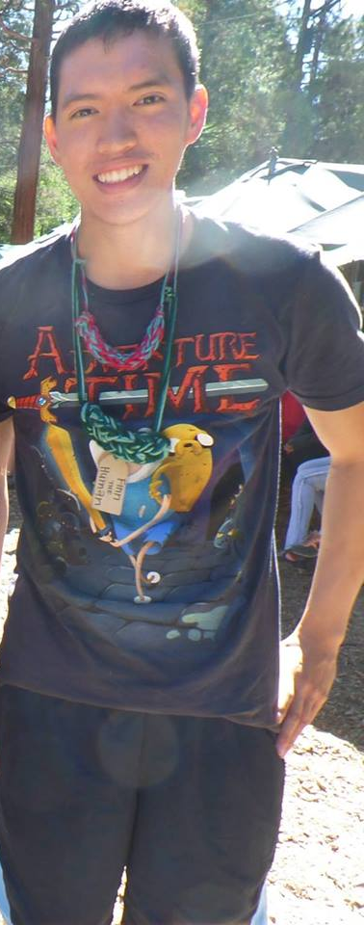
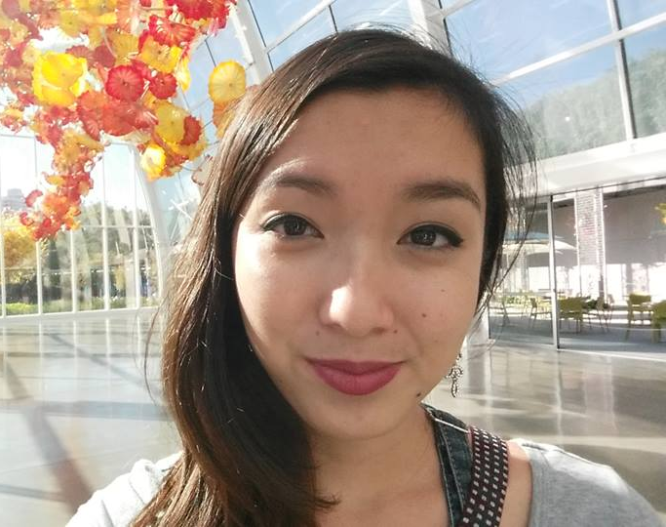
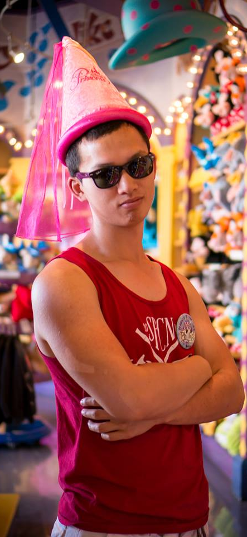
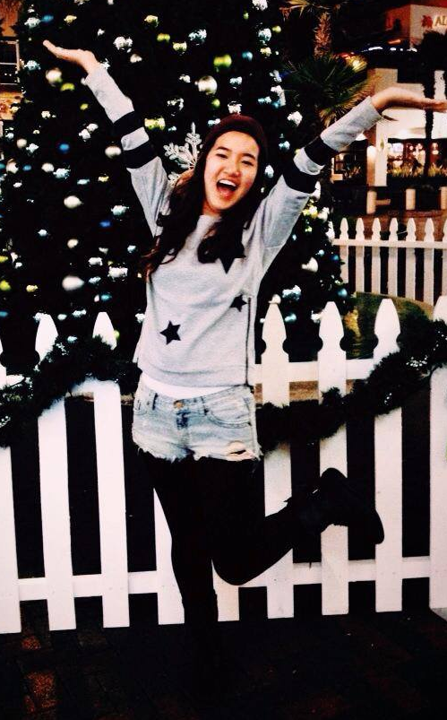
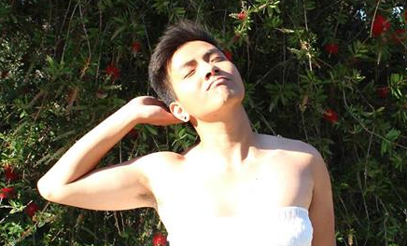
Introducing our new PAC!

Slide 35

What we do:
Our goal:
To develop Leaders through Brotherhood.
Create meaningful opportunities to bond
Help develop leadership skills
Educate about Chi Chapter History
Be our derpy selves & support you

Slide 36

What to look out for this week!
Pledge Bonding day: 10/18
Class Unity, Mascot, Class Name, and Auto Bios due CM2
8 Active Interviews due CM2
PIF groups begin!
PlexComm nominations

Slide 37

Please come out to Kerckhoff Patio!
Please come out to the wondrous area which is Kerckhoff Patio to meet the Alpha Mu Pledges :)!
Try to wear your Letters as well!
it’s oki Batman~
walking is good 4 ur health :3

Slide 38
Finance VP
Jonathan Liu
finance@apo-x.org

Slide 39
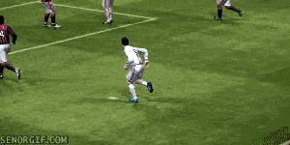
WELCOME PLEJES

Slide 40
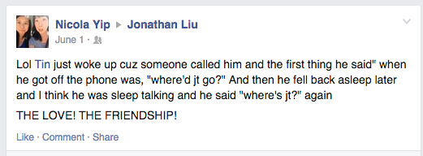
Thanks Tin!

Slide 41
Thank you Tin!
Student Organization Operational Fund
Still working tirelessly in the background
Fantastic co & all round person

Slide 42
Dues!
Use the following formula to figure out how much you have to pay!
D = $75 - $2.5 (# of good standing terms completed)
e.g. Alpha Lambda class:
D = $75 - $2.5 (0)
D = $75

Slide 43
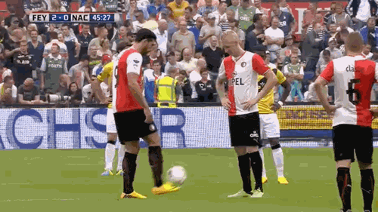
Dues!
Pay dues at CM3
Cash or cheques payable to “Alpha Phi Omega - Chi Chapter”
Please follow the policies

Slide 44


Fundraising Committee
If you’re interested in furthering the fundraising mission of APO then this is the right committee for you!

Slide 45
Venmo!
Would you, the Chapter, be okay with me merging the APO debit card & bank account onto my personal Venmo account?
(i.e. you guys will all be sending payments to “Jonathan Liu” on Venmo)

Slide 46
Fellowship VPs
Ann Dai & Danny Ly
fellowship@apo-x.org

Slide 47


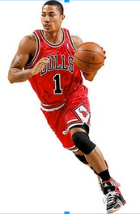

It’s AM term woo hoo!!
Sign up for events
(Meet the pledges!!!!!!!)
Bunch of fellowships
are up
2-3 fellowship events per week
October >> FOOD!
November>> Outdoor events!

Slide 48
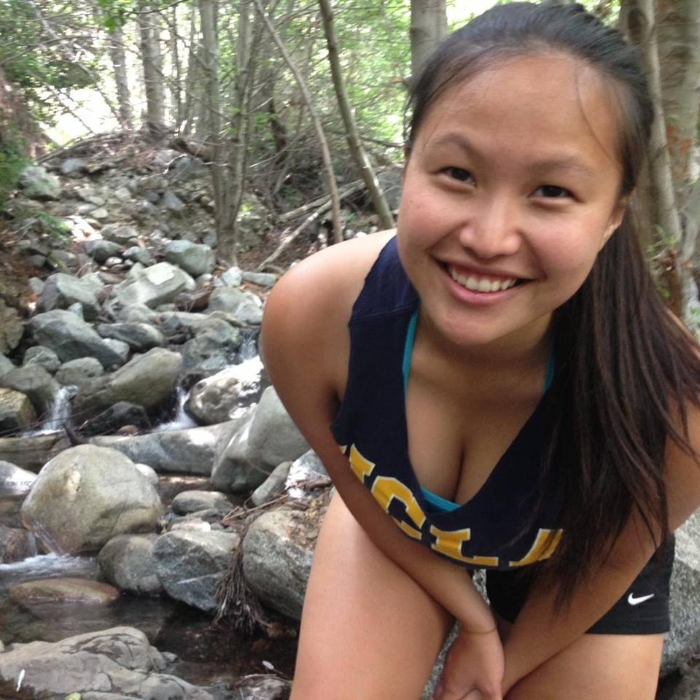
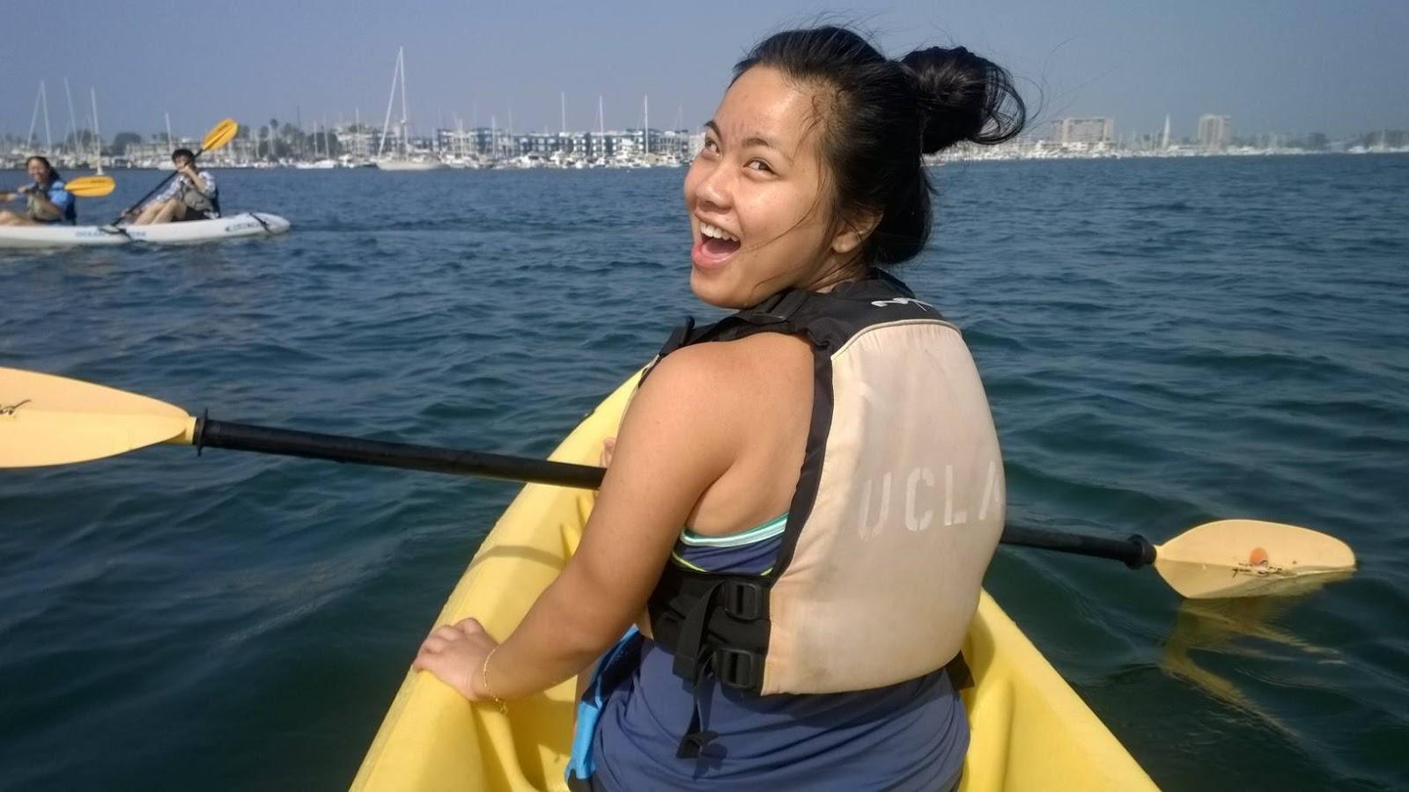
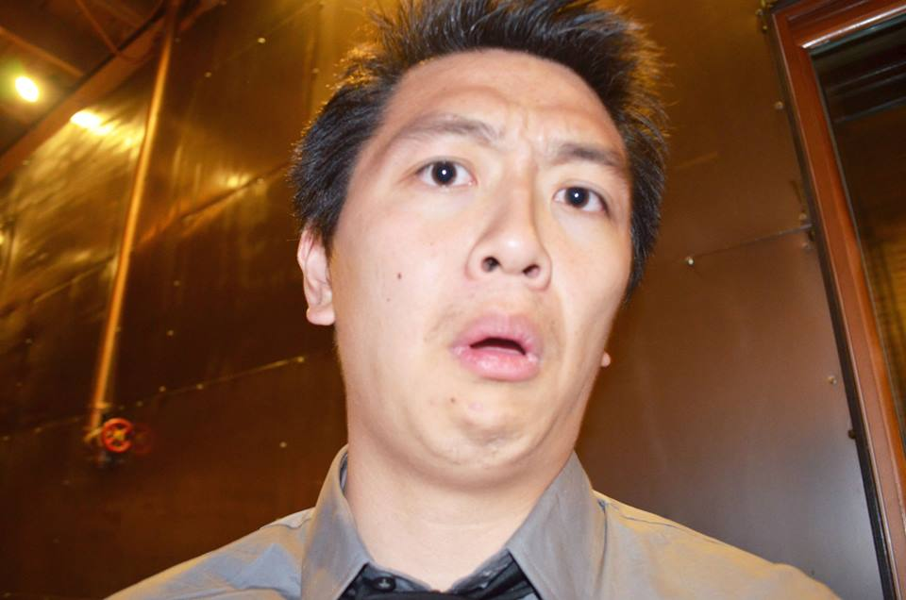
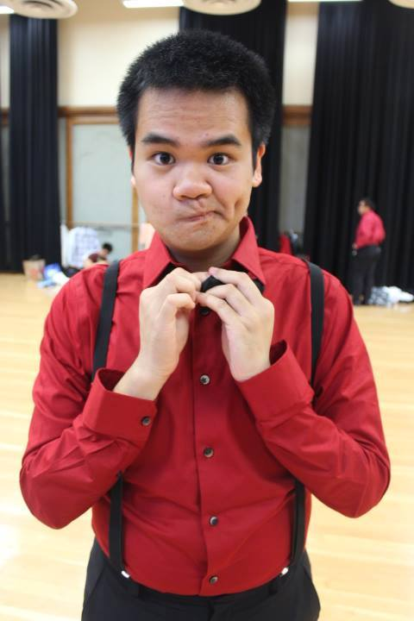
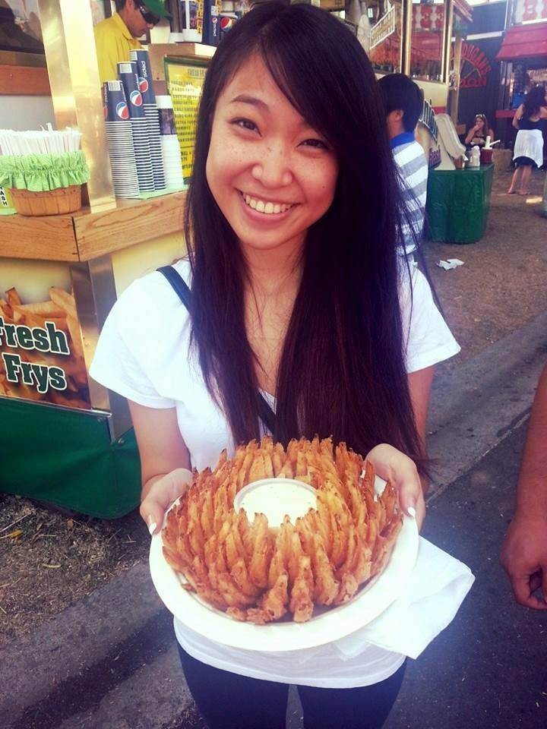
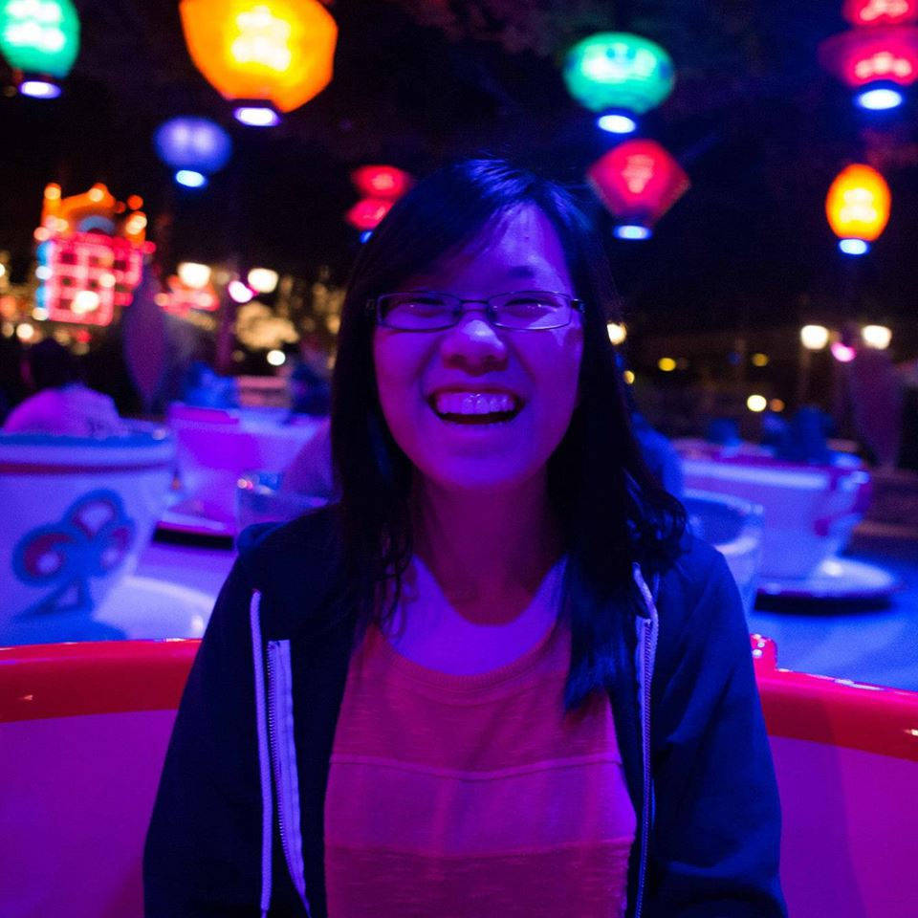
Fabulous Fellowship Committee
Special Event:

Slide 49
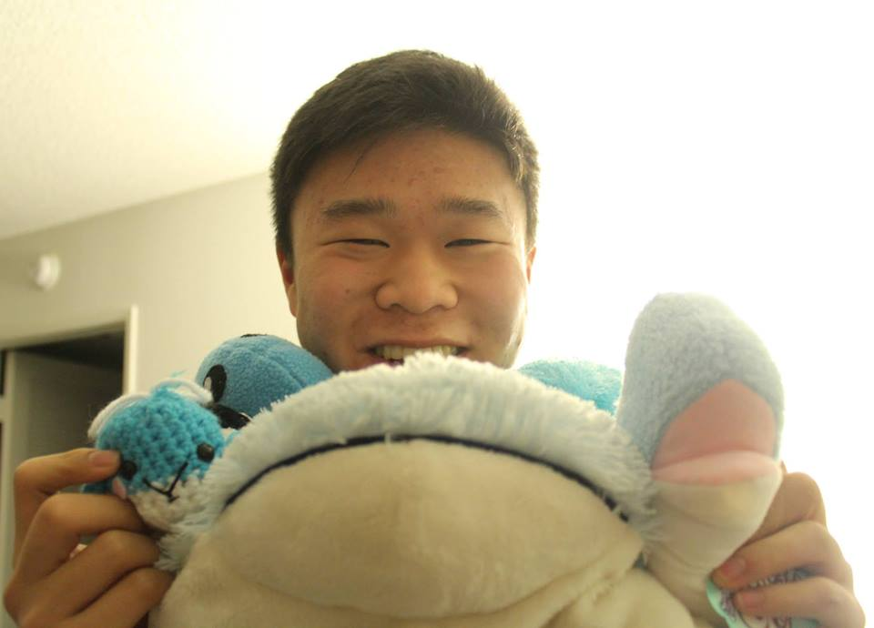
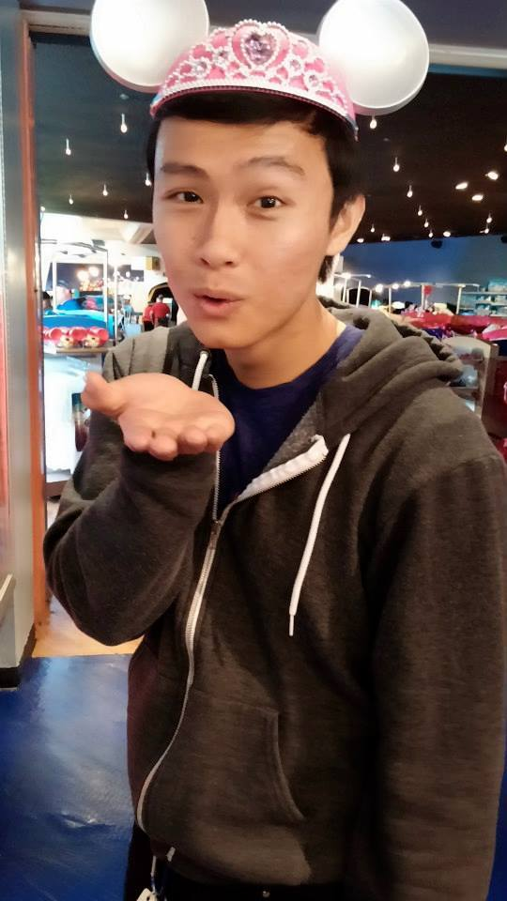
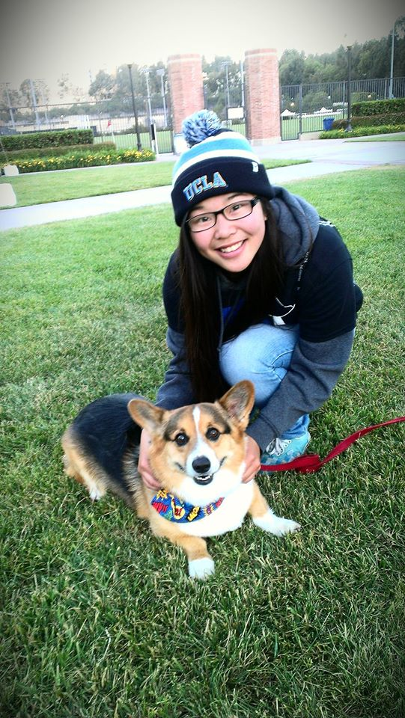
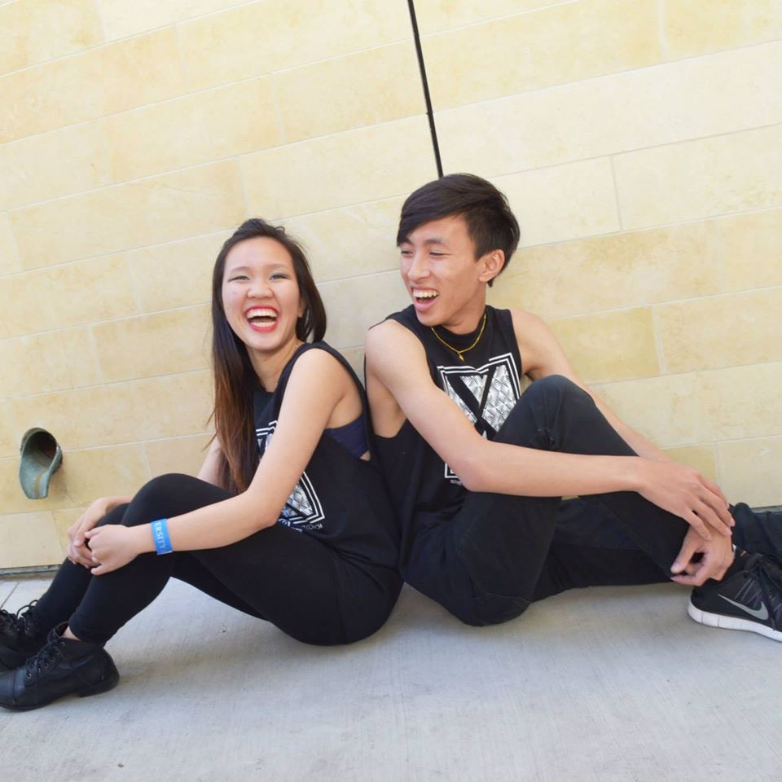
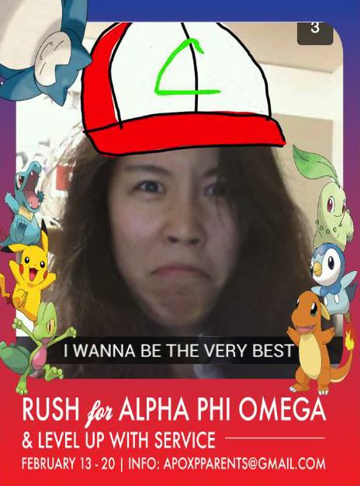
Fabulous Fellowship Committee
Fun Foursies: Chivergent: IM Team: Tracking:

Slide 50

how do we give fellowship credits ?
Fun Foursies: Complete 2 times = 1 credit
Chivergent: Complete 1 & 2 = 1 credit
Complete 2 & 3 = 1 credit
Complete 3 & 4 = 1 credit
If you finish 1&3, 1&4 or 2&4 = NO CREDIT!!
IM team: Go to 2 games = 1 credit

Slide 51

New program: Chivergent!!!!!!!!!!!
4 missions - we will announce them in order
First mission: 8 groups
Second: combine to 4 groups
Third mission: combine to 2 groups
Last mission: Combine to 1 big group
Sign up on the calendar 10/21/14
First mission will be given CM2 and
due CM3

Slide 52
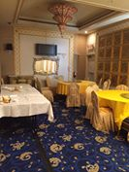
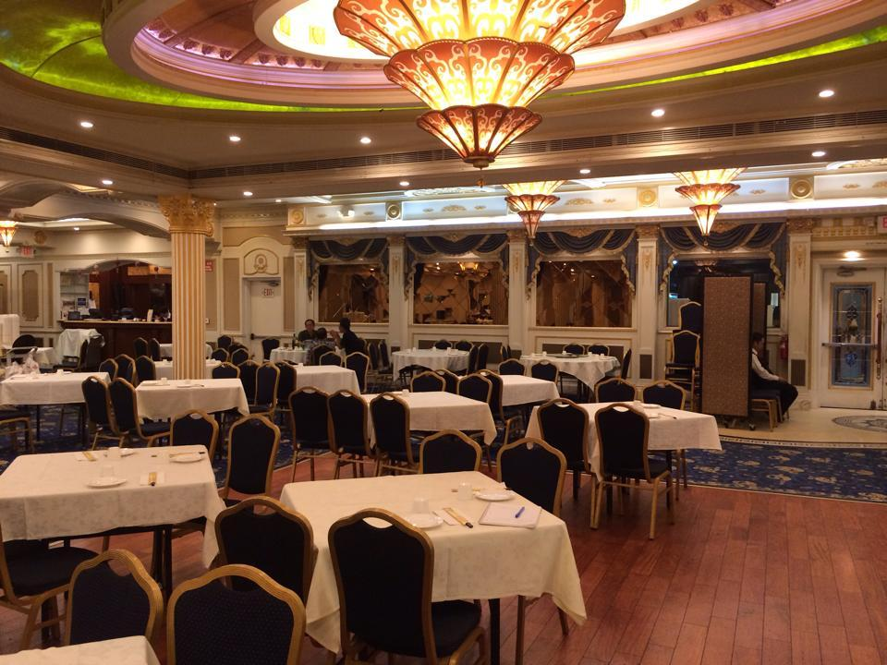
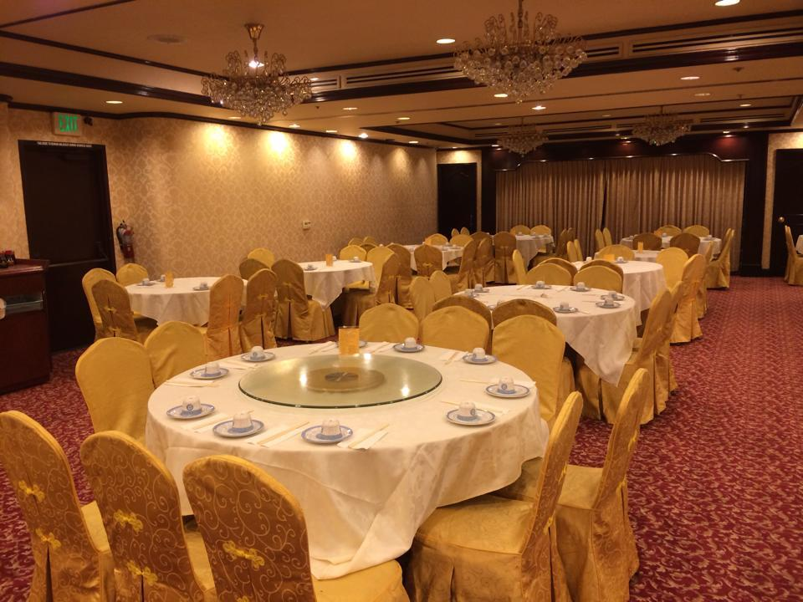
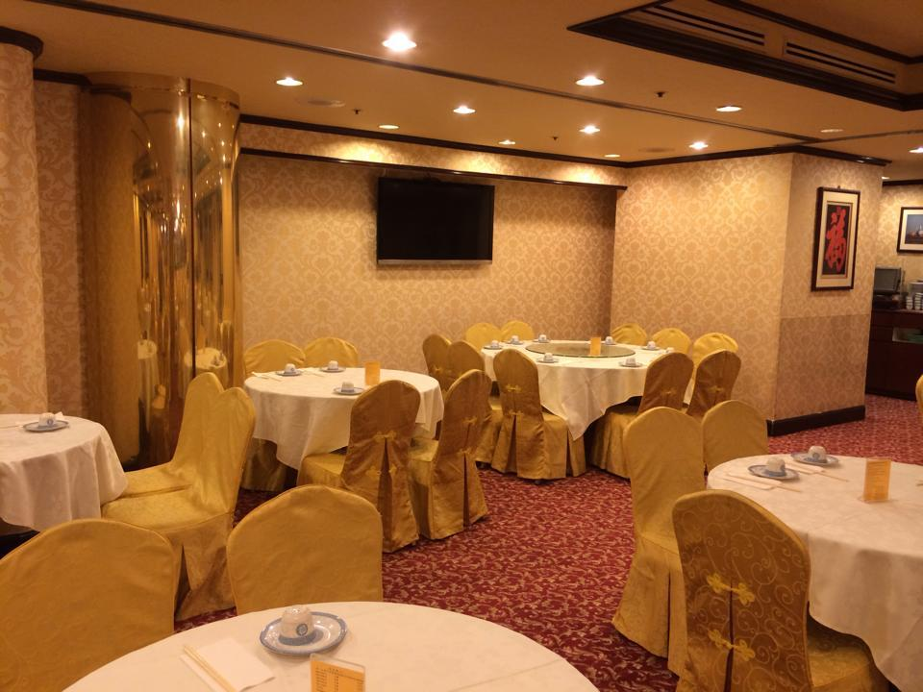
Looking Good Night <3
Cheaper for LGN & fancy for BANQUET
First restaurant:
$25/person, Chinese food
20 miles away
Second restaurant:
$22/person, Chinese food
20 miles away
Third restaurant
$28-32/person, American food
22 miles away

Slide 53

Fellowship events
Give us some creative ideas =)
Need a chair for “Meet the Pledges”
After meeting>>> In N Out fellowship
Actives> Cindy Nguyen
Pledges> Lisa Lau
Flake-in> Ann Dai

Slide 54
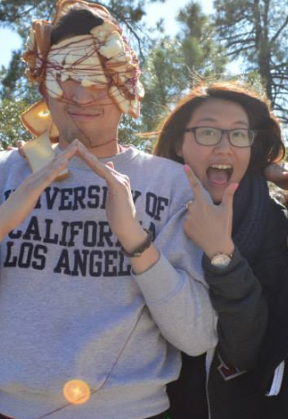
Contact us =) Thank u!!!
If you have any questions or suggestions!
Email: apoxfellowship@gmail.com
Danny: dly418@yahoo.com
(510)332-2512
Ann: anndai918@gmail.com
(571)425-3630
Your opinions are important to us!

Slide 55

Historian
Juana Li
historian@apo-x.org

Slide 56
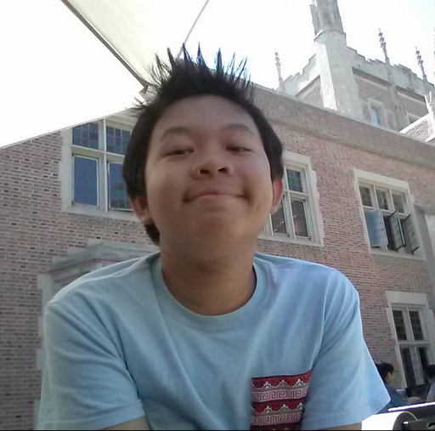
Join My Committee!!
Positions Open:
-Brother of the Week (1)
-Pictures/Videos (1)
-Webisodes (2)
-Term Book (1)
Kevin Vu

Slide 57

Brother of the Week
Send Me Nominations
Email: apoxhistorian@gmail.com
Text: 510-552-3459
*Recognize a Brother!
Kevin Vu

Slide 58
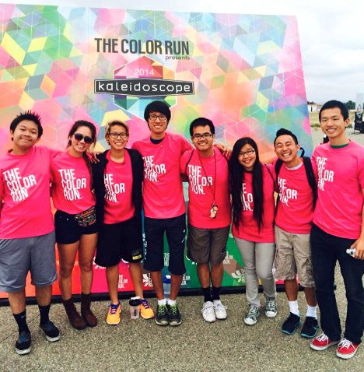
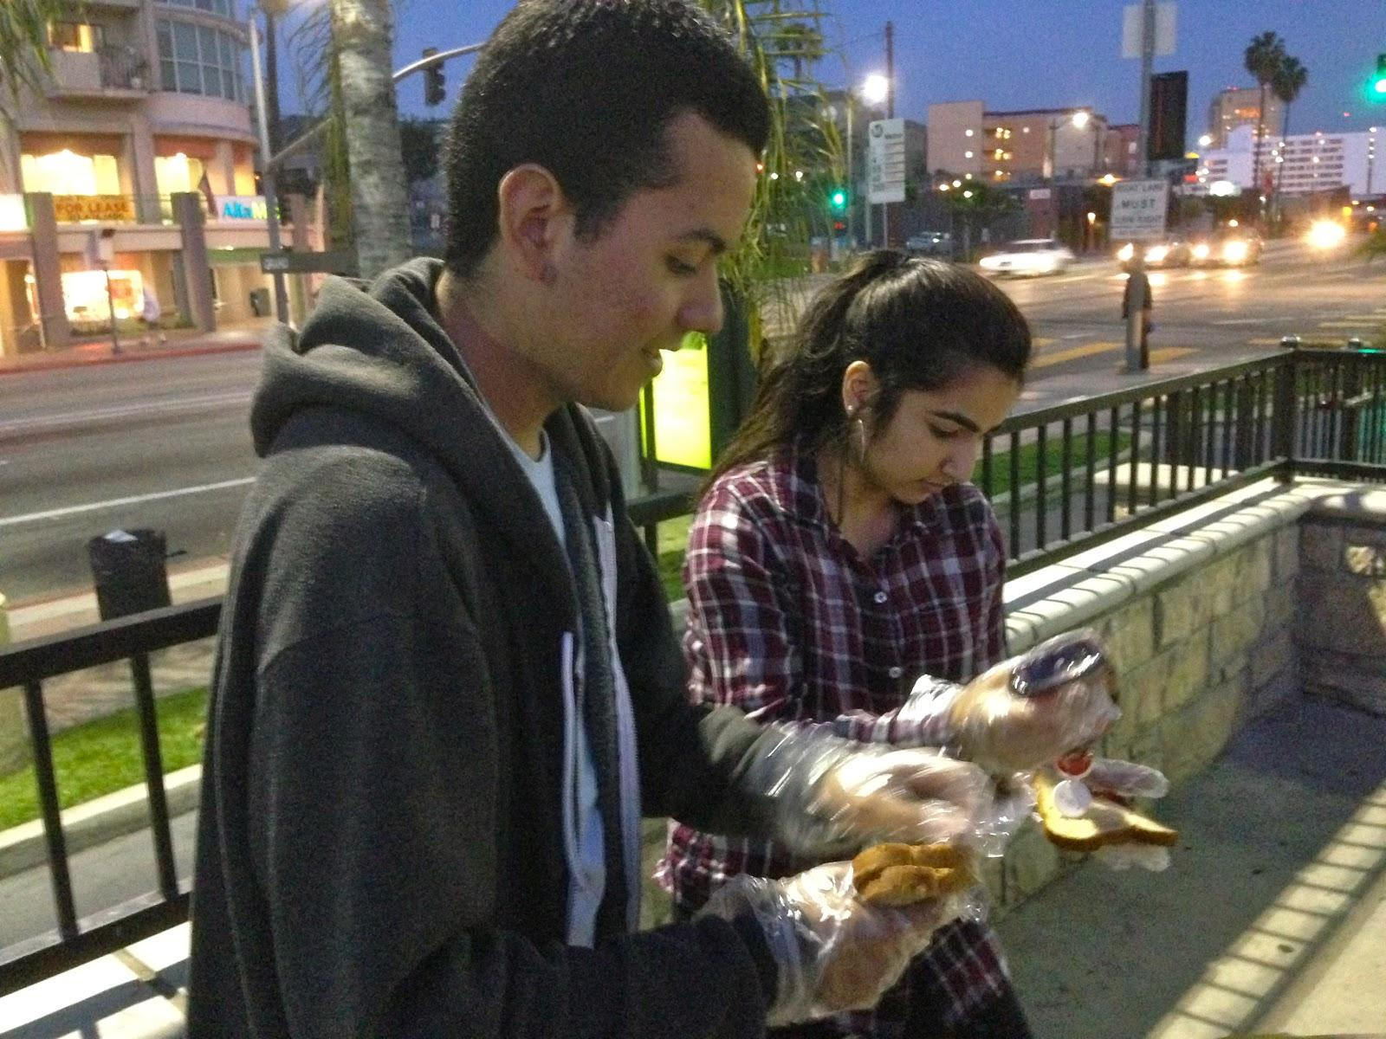
Chairing Pictures
Send Pictures to apoxhistorian@gmail.com
Kevin Vu

Slide 59
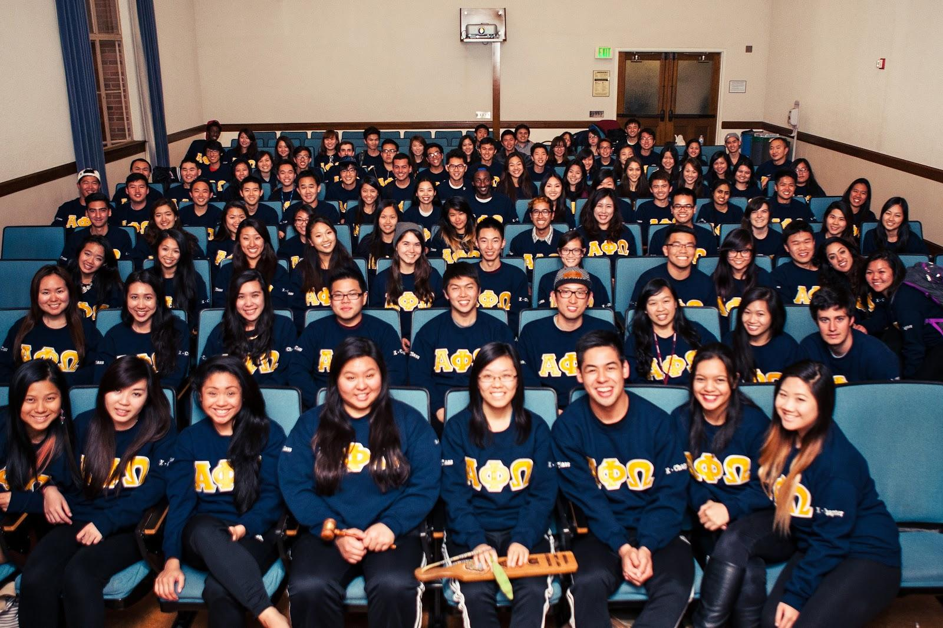

Upcoming...
Wear your STANDARDS CM2!! Plox ^_^
Kevin Vu

Slide 60
Sergeant-at-Arms
Josh Chin
apoxsergeant@gmail.com

Slide 61
How to Chair
Go on website and click on the specific event you want to go to, press “Become Chair” button
7 days to complete evaluation with credit
No evaluation/reminder emails/call = 1 strike; no chairing credit
Send reminder e-mails whenever as long as it is AT LEAST 1 day prior to event date (must still call all attendees 1 day prior to event)
if there is no chair, SAA will text, e-mail and call random chair morning of prior to event
chair MUST also send pictures to Historian or he/she will receive no credit and a strike for improper chairing
everything else same as last term
toast song
organize rides
etc

Slide 62
Strikes (Actives)
Makeup strikes:
LFS
Must notify SAA that he/she will be using specific events for strike makeups (this means he/she will not receive credit for the event)

Slide 63
Strikes (Pledges)
notify SAA immediately if you lose your pin
use lost pin form: https://docs.google.com/forms/d/1VadIGN4NbwgZXs_bfGj2O_-NJL0CnDGEq5SFJa4Pd5g/viewform (on website)
timestamp on google doc is the one SAA will use
$5 for lost pin
If active reports pledge for no pin before pledge submits google doc, said pledge will receive a strike UNLESS pledge notifies SAA via text/email/call that he/she lost pin before active reports the strike

Slide 64
Meeting
Card strike (yellow, orange, red)
Card strikes are cumulative
3 yellow total = 1 strike
2 orange = 1 strike
1 red = strike
will reset after

Slide 65
Meeting (attendance)
15 minute grace period
anyone who comes after 7:15pm will not receive credit for meeting and receive a strike
Must notify SAA at/before 6PM SHARP
text leaving full name and time leaving/arriving
Will create list of people leaving early/coming late by 7 PM
must stay for at LEAST one hour (8pm)
if your name is not on the list and you LEAVE, you get:
1 full strike
no meeting credit

Slide 66
Interchapter Chair
Chanel Ng
interchapter@apo-x.org

Slide 67

ICs in da house~~~
Welcome Alpha Kappa!
Hangout in Westwood after CM. Sign in with William Nguyen.

Slide 68

Welcome AM Pledges

Slide 69

What I Do
I do it for the Friendship~

Slide 70
Upcoming IC Events
October 18th: Ultrazone (laser tag) and Phil's BBQ event at 5 PM with Alpha Delta in SD
October 19th: IC Park Day at South Mission Beach in San Diego at 1 PM
November 7th: Rho Rho Disney Scavenger Hunt
November 8th: Dodge-Ball Tournament by Lambda Mu (CSULA)
November 21st: Powderpuff Football by Rho Gamma (CSULB)

Slide 71

National Convention 2k14
When: December 27-30, 2014
Where: Chicago, Illinois
Represent Chi Chapter~~
Please welcome Taylor Briglio

Slide 72
CAC
Paul Choung
cac@apo-x.org

Slide 73

the big picture

Slide 74
Voting Delegates Election
Nominees:
Chanel Ng
Bowen Lu

Slide 75
Voting Delegates Election
Election Structure:
*Must have quorum (Over 50% of active body)
For each candidates
3 minute speech
5 Q&As
Possibly motion to extend questions by “x” amount
Closed discussion on candidate
Repeat until all candidates have finished
Closed discussion on all candidates
Vote by ballot

Slide 76

Section 1 Sectionals
April 25th

Slide 77
Committee Positions
Design/Marketing 1
Finance 1
Programming 1
Food 2
Housing 2
Internal Affairs 3
Publicity 3
Workshops 3
Banquet 5

Slide 78
Chapter Business
Special Elections - Finance VP

